Slide 1
In The Name Of Allah

Slide 2
Graduation
Project
Presentation
General Ledger Operations And Financial Reporting In Oracle ERP

Slide 3
NXT44_ONL1_ERP1_S1e Team 3
Prepared By :
Nabil Mohammed Elsayed Abdelfattah : create and post journals and reversing journals
Verna Philip Zakaria Philip Zakaria : Recuring journals and inquiry and drill - down
Omar Makram Abdellah open and close accounting periods and perform month -End close
Kareem Mostafa fouad Ali : Mass Allocation Of Expenses to cost centers
Esraa Hamdy Osman : budget monitoring and Generate Final Financial statement
Mohamed Ahmed Ahmed Abdellah : Currency and Exchange rate management and Financial Reports
Track : Management and ERP
Supervisor : Mr. Ehab Ahmed
Date : 15 oct 2024

Slide 4
Create and post journal
Reverse and recuring journals
Multi-currency management
Period management
Budgeting and Reporting
General ledger operations

Slide 5
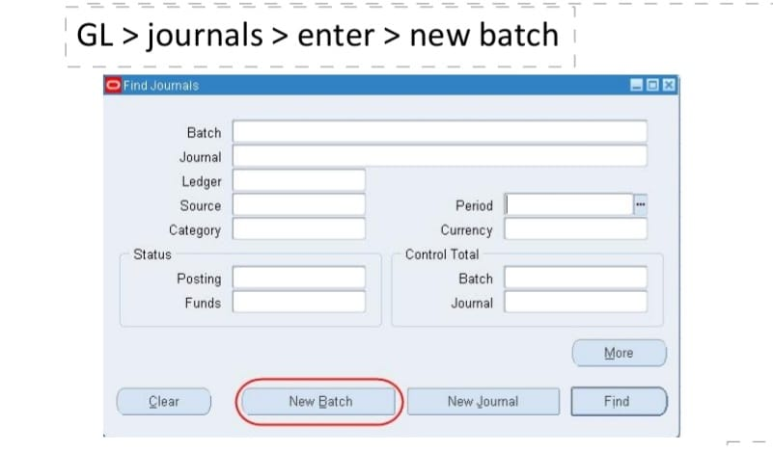
Basic Journals
GL vision operations USA JOURNALS Enter
There are two methods of entering journals, the former acting as a batch and the latter registering separately
BATCH METHOD

Slide 6
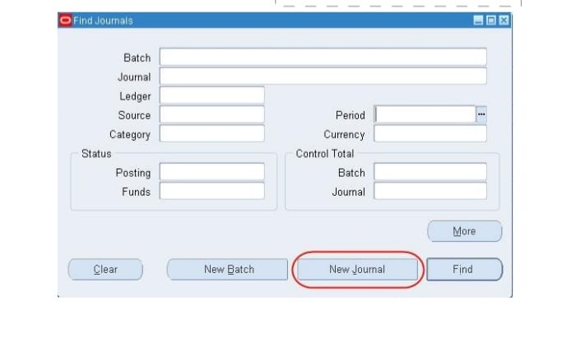
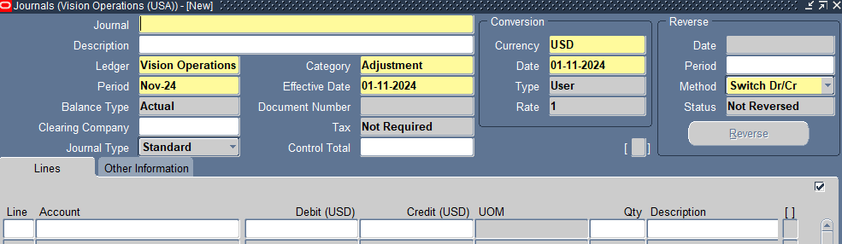
SINGLE JOURNAL METHOD

Slide 7
CREATE AND POST MANUAL JOURNAL
Enter Header Information
in the Journal Entry screen, fill in details like :
Batch Name (for grouping related journal entries)
.Journal Name (a specific identifier for the journal).
Period (the accounting period in which the journal will be posted).
Currency (the transaction currency, usually the functional currency)
Description (optional, for explanation).

Slide 8
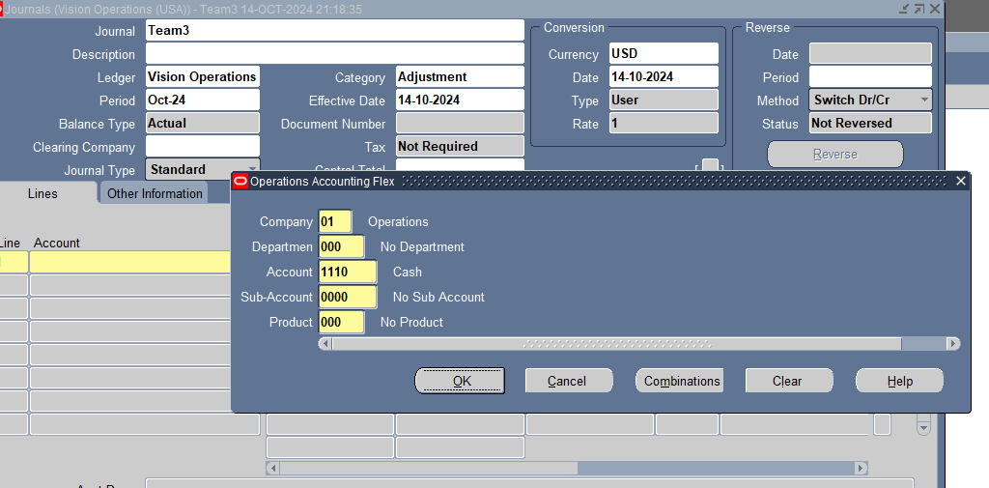
HEADER INFORMATION

Slide 9
Enter Journal Lines:
Specify the Account number (GL code combination)
Enter Debit and Credit amounts
Ensure that Debits equal Credits for a balanced entry
Validate the Journal:
Once the journal is entered, you can run a validation to ensure the entry is complete and accurate
Post the Journal:
After validation, post the journal by selecting Post
This updates the General Ledger and makes the entry part of the financial reports.

Slide 10
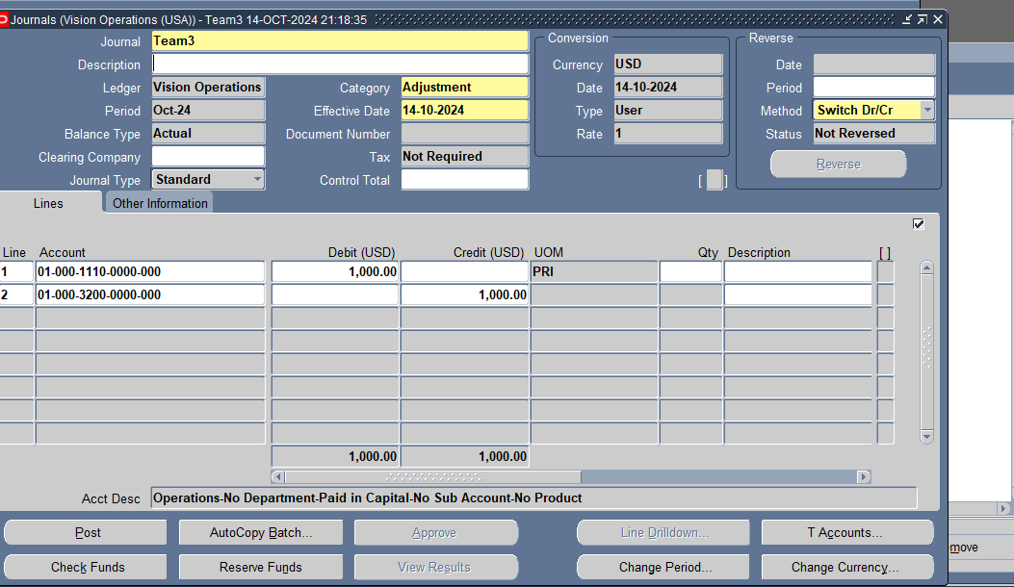
ENTER JOURNAL LINES

Slide 11
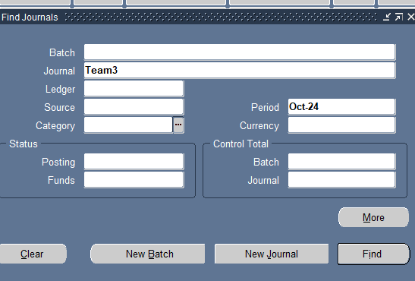
REVIEW POSTING STATUS

Slide 12
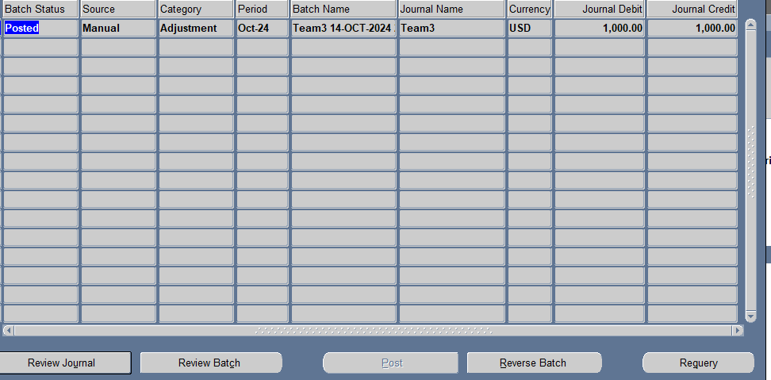
To Review Posted Journal

Slide 13
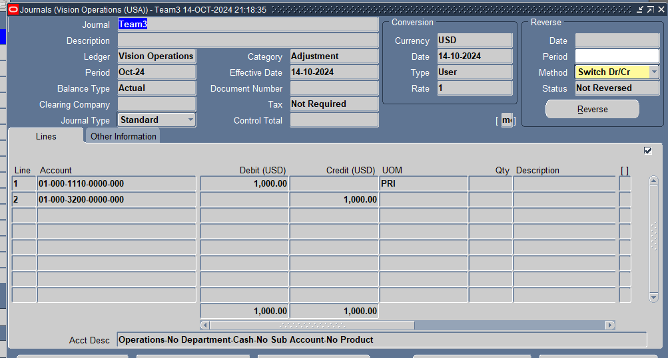
Posted Entery

Slide 14
REVERSE JOURNALS
A Reverse Journal refers to the process of reversing a previously posted journal entry. This is typically used to correct mistakes or make adjustments for temporary transactions. The reverse journal effectively creates a new entry that negates (or cancels out) the original one.
Types of Reversals:
Switch Dr/Cr: Reverses the debit and credit amounts.
Change Sign: Changes the sign of the amount without switching debit and credit.
Process:
Navigate to the Journal Entry screen.
Query the journal you wish to reverse.
Choose Reverse from the actions
Select the reversal method (Switch Dr/Cr or Change Sign.
Post the reversed journal.

Slide 15
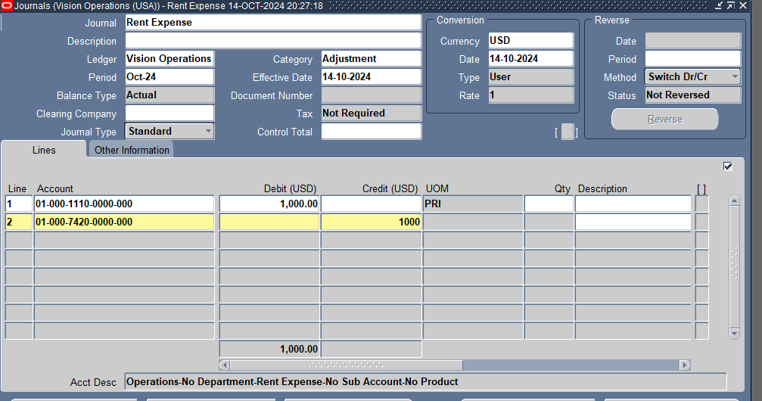
Incorrect Journal Entery

Slide 16
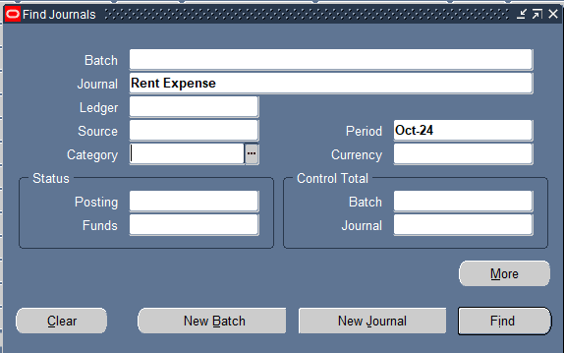

Slide 17
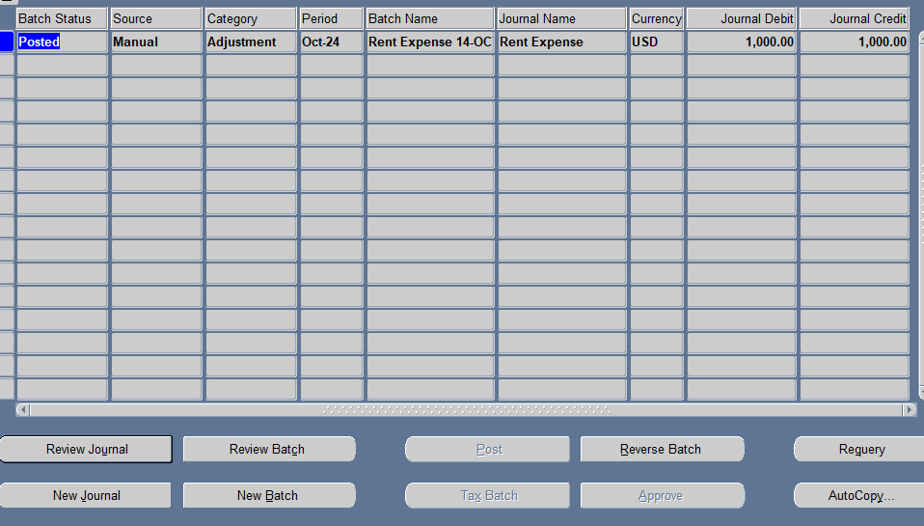

Slide 18
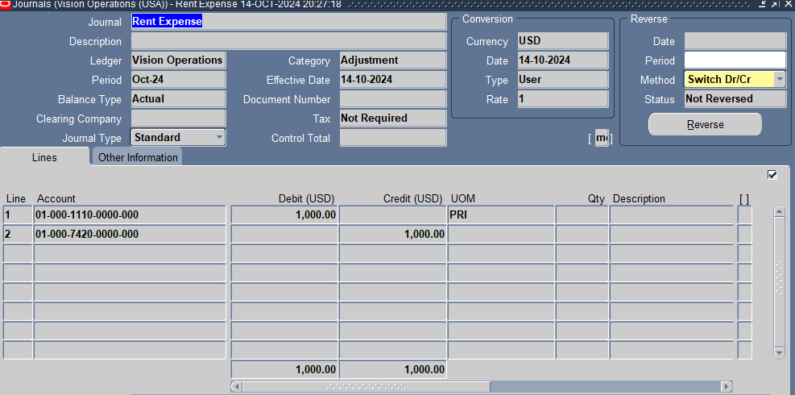

Slide 19
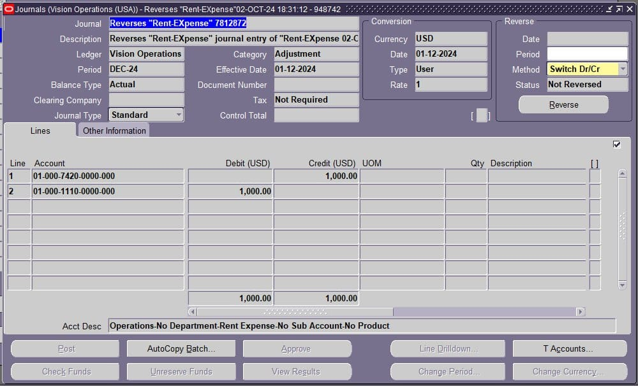
REVERSED JOURNAL

Slide 20
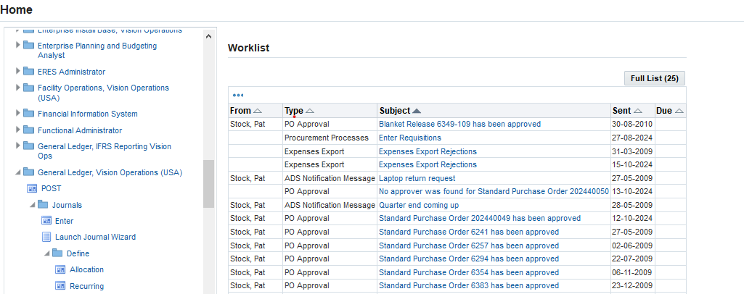
Recurring Journals
From Navigations .1
•General Ledger > Define > Recurring Journals .
.

Slide 21
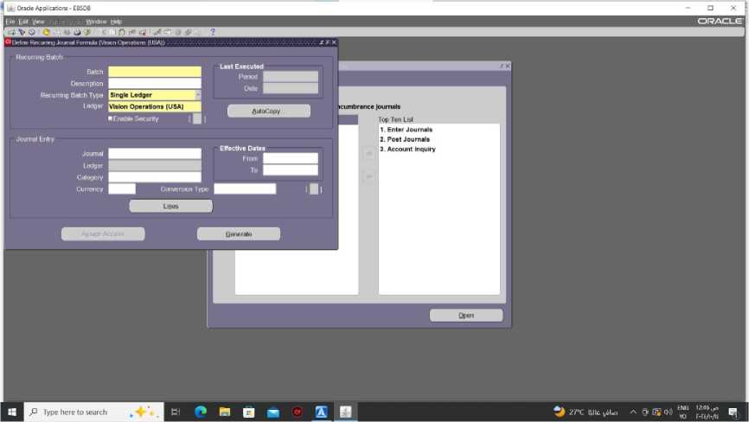
2.Then will appear:-
Define Recurring Journal Formula

Slide 22
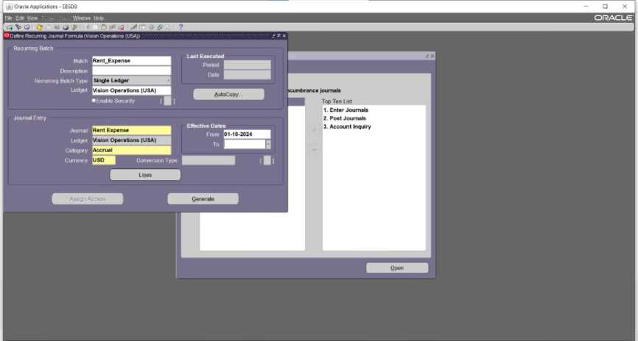
3.Fill the Recurring Journal Formula with rent expense account :-

Slide 23
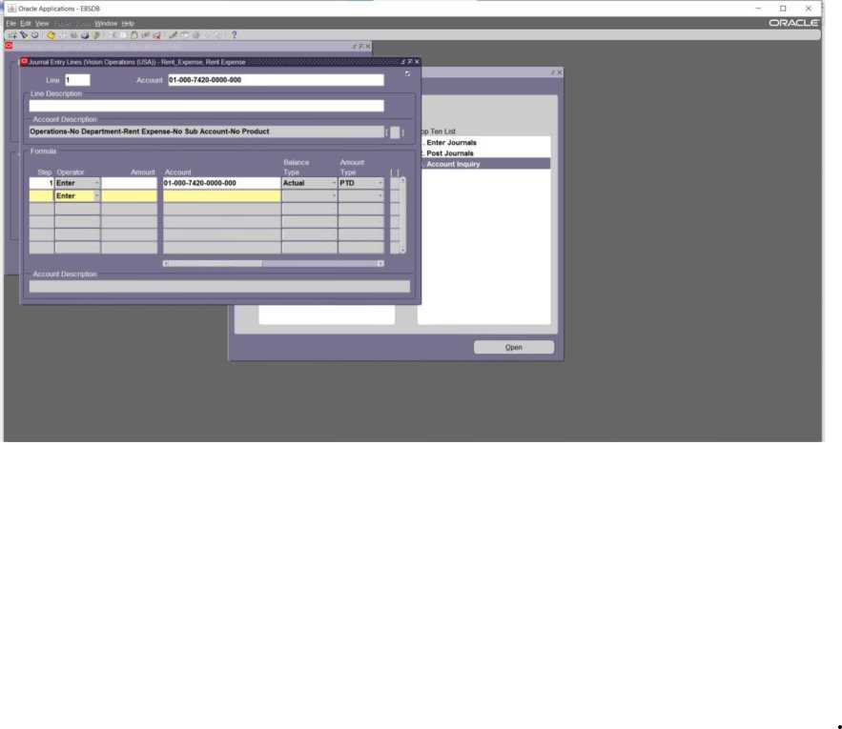
4. click on "Lines" to complete the Recurring Journal:-

Slide 24
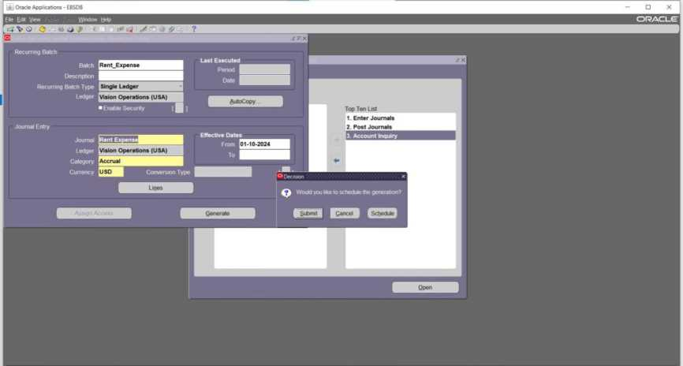
5. After completing "Journal Entry Lines" Click "Generate " to schedule and post recurring journal.

Slide 25
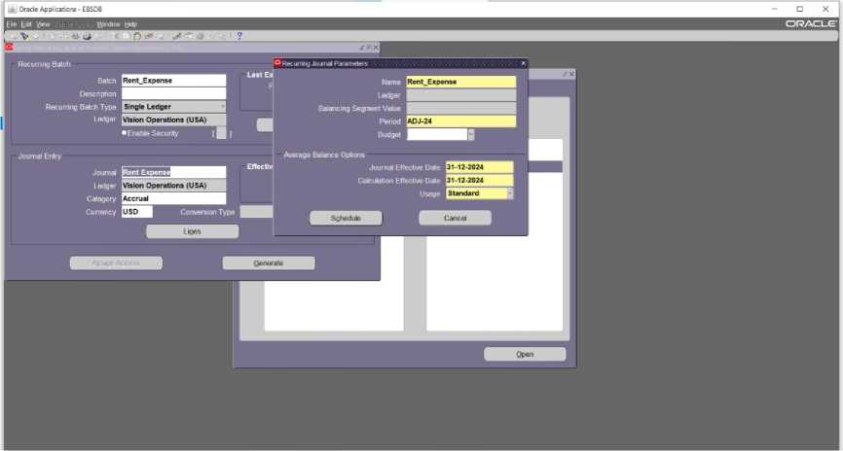
6.to set recurring journal parameters

Slide 26
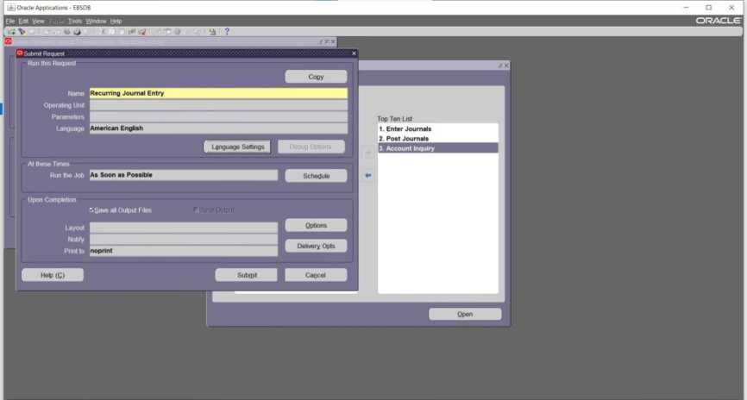

Slide 27
Notes for define a recurring journal formula:-
1. Batch Section:
Batch: Enter the name of the batch that identifies this set of recurring journal entries.
Description: Provide a meaningful description for this batch.
Recurring Batch Type: Choose the batch type. "Single Ledger," which means the recurring journal applies to a single ledger.
Ledger: Select the appropriate ledger (in this case, it's "Vision Operations (USA)").
2. Journal Entry Section:
Journal: Enter the name of the journal that will be generated.
Ledger: Select the ledger for this journal entry.
Category: Choose the category of the journal .
Currency: Specify the currency for the journal entry if it's different from the ledger's currency.
Effective Dates:
From/To: Specify the date range for which this recurring journal is valid.
Conversion Type: If applicable, enter the conversion type for foreign currency transactions
3. Lines Button:
Click Lines to enter the specific accounts and amounts that will be debited and credited in this recurring journal.
4. Generate:
Once everything is filled, you can click Generate to create the recurring journal formula.

Slide 28
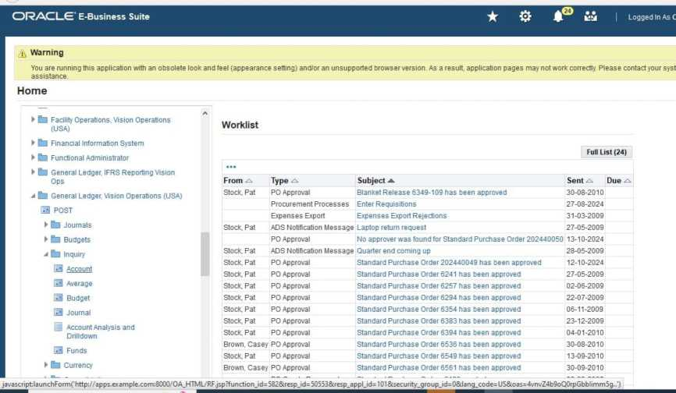
Inquiry and Drill-Down What is it ?
*GL Inquiry allows you to view posted journal entries in the system, giving visibility into the financial transactions recorded. It’s helpful for reviewing
financial data like account balances for a
particular time range.
*Drill-down means you can explore further details about these journal entries by looking at individual transactions and
specific account details.
Accounts Inquiry
.from navigation:-
Inquiry >Account
2. Choose the period you want to Inquiry for it

Slide 29
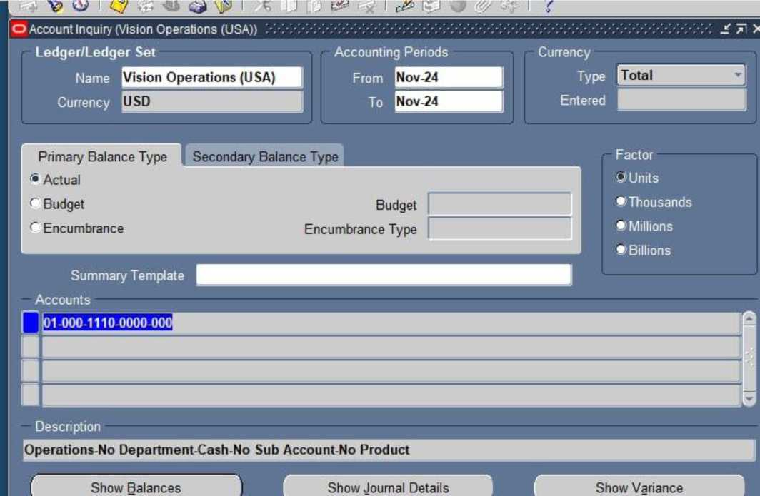
*Accounting period :- set the accounting period ,you want to check the balances in that
period.
*Accounts Field:-This may represent a specific account, department, or segment in the chart
of accounts. Ensure that the
account code corresponds to the account you're trying to review balances for
3.The next step is to click the "Show Balances” . This will retrieve and display the account balances based on the
period, account, and balance type selected (Actual, Budget, or Encumbrance)

Slide 30
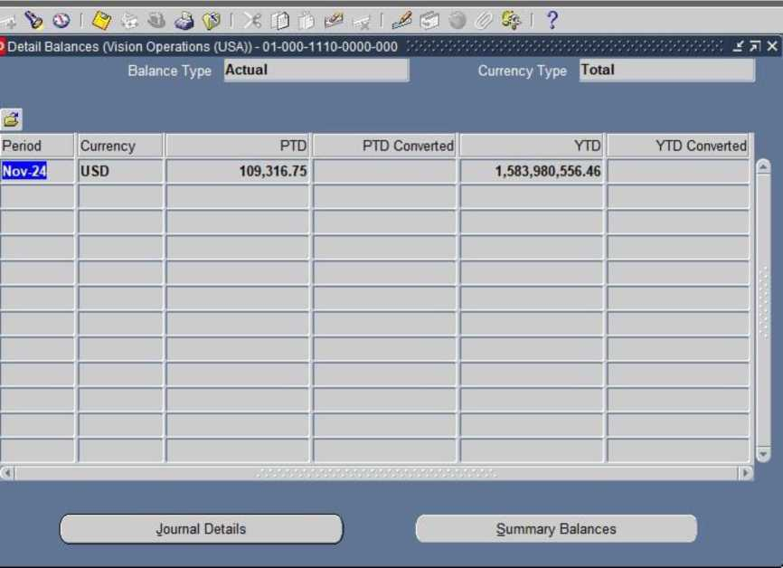
*Balance Type: It shows Actual balances, which means the real financial data (not
budgeted or forecasted).
The column marked as PTD(period to date)shows the balance for the selected
period.
*The YTD(year to date)column shows the cumulative balance from the beginning
of the fiscal year up to
the end of the selected period.

Slide 31
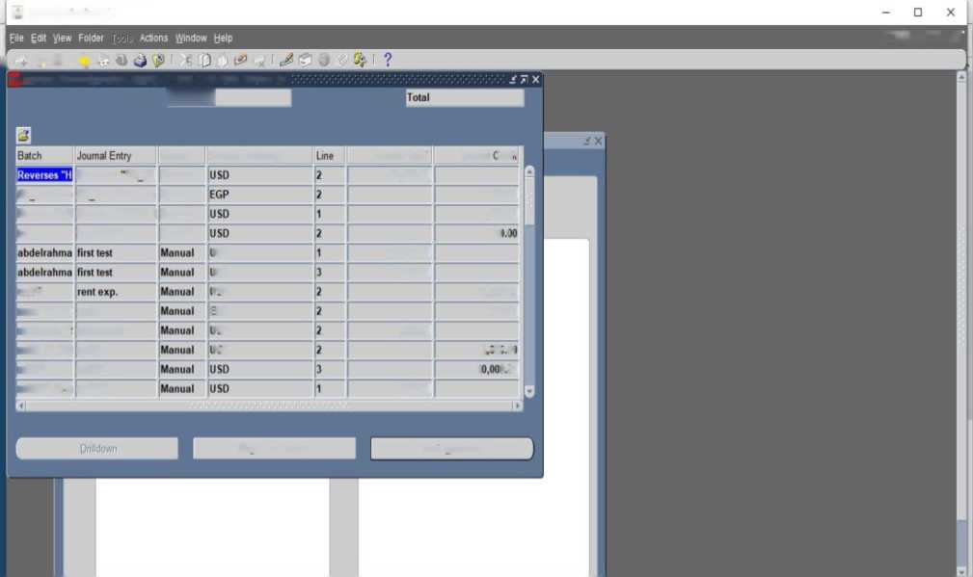
4.choose Journal Details to see the individual journal entries that make up
the balance.
ORACLE

Slide 32
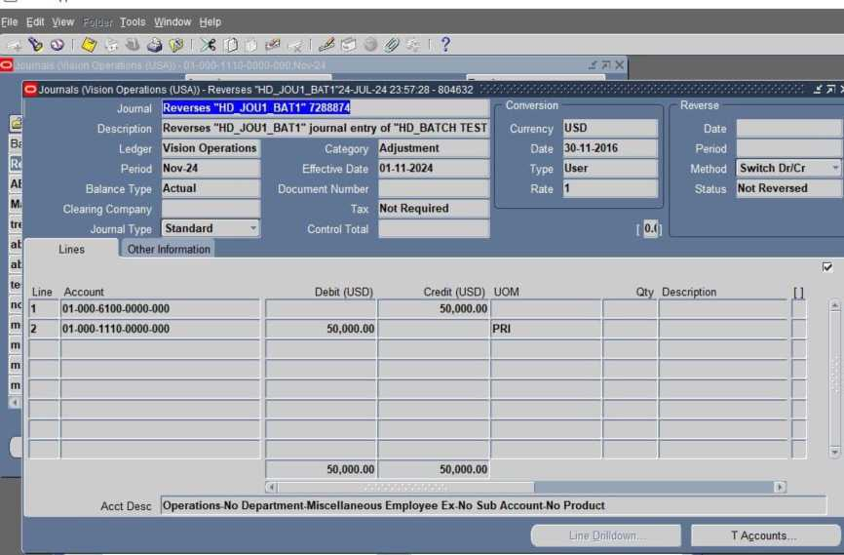
5.click"Show Full Journal”
To see all information related to the entry and
transaction.

Slide 33
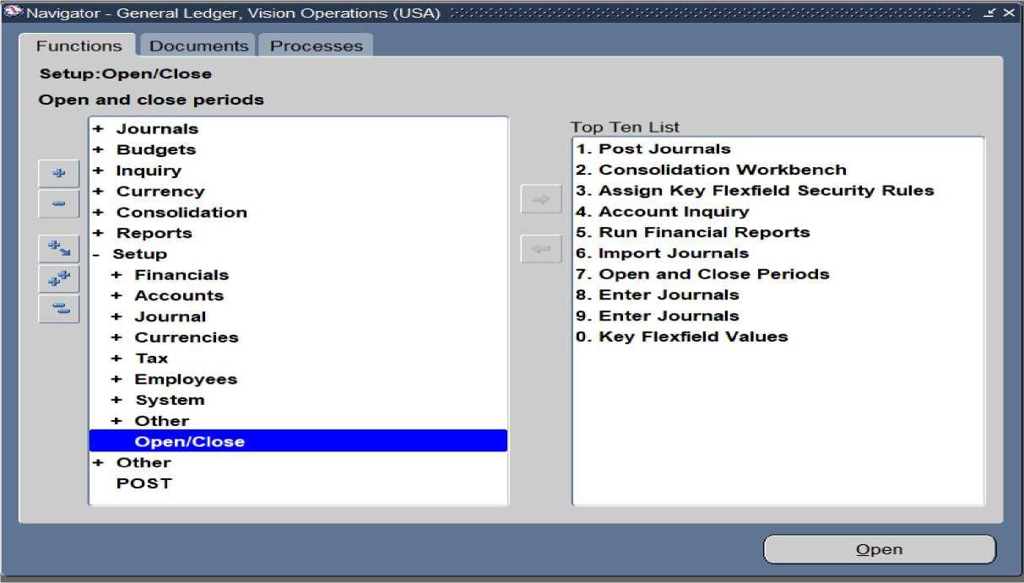
Open and Close Accounting Periods:-
Steps for Opening and Closing Accounting Periods in Oracle EBS R12
Access the General Ledger (GL) Module:
1- Log in to Oracle EBS.
2- Select the Responsibility related to General Ledger (General Ledger).
To Open the Accounting Period:-
1-Navigate to Setup > Open/Close Periods
2- Choose the Ledger where you want to open the period.
3- Select the period you wish to open (usually the current or future period).

Slide 34
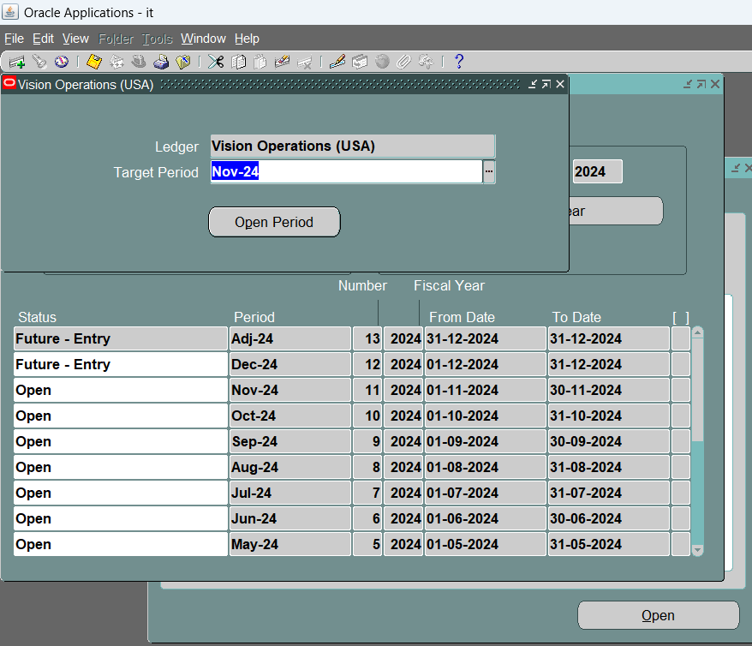
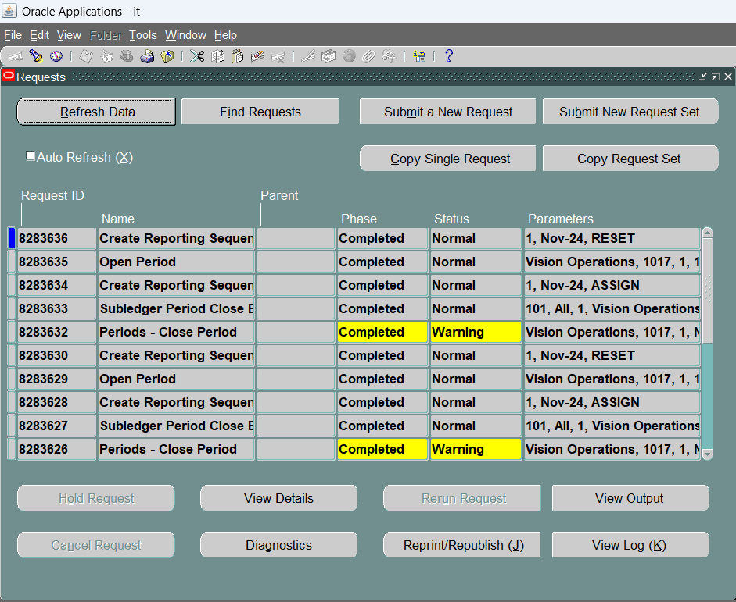
4-Click Open Period to open the selected period.

Slide 35
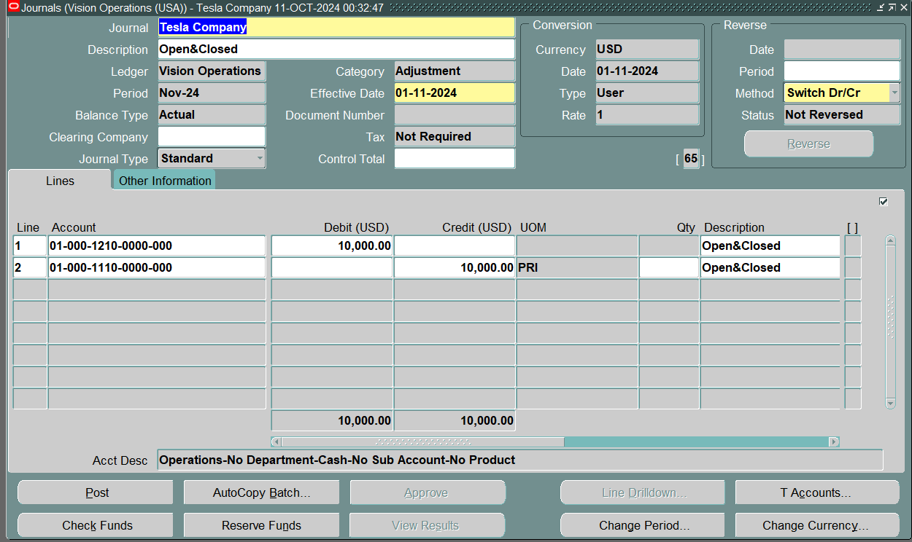
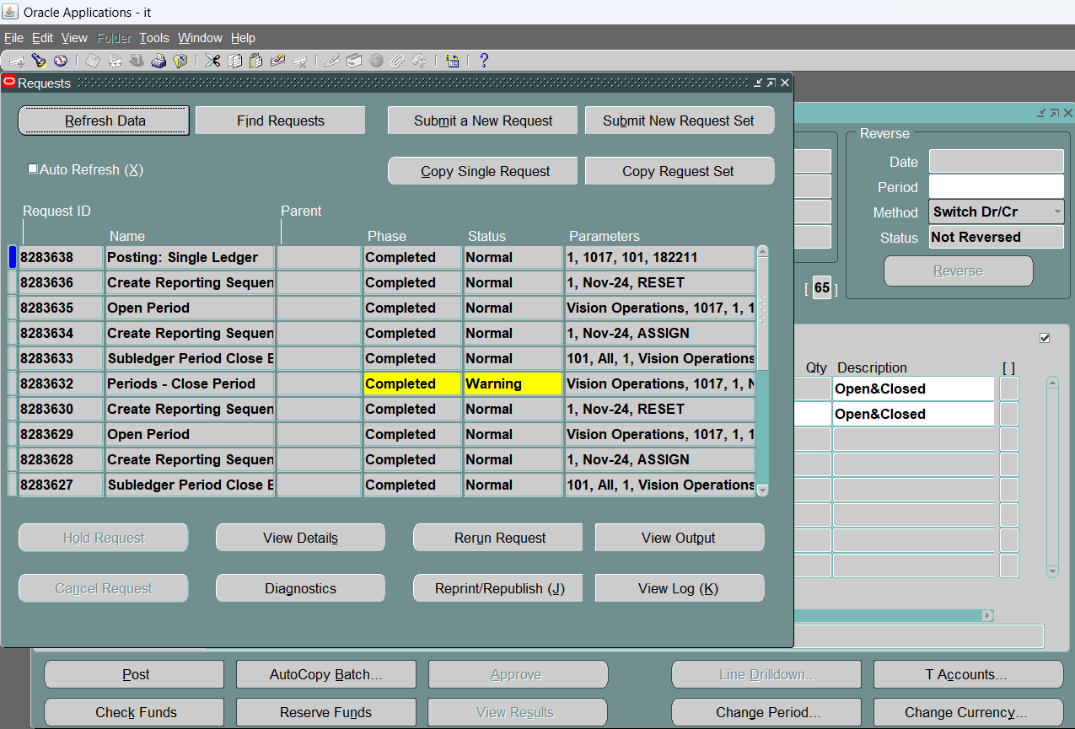
To Close the Accounting Period:-
1- From the same screen, select the period you want to close.
2- Ensure all journal entries have been posted.

Slide 36
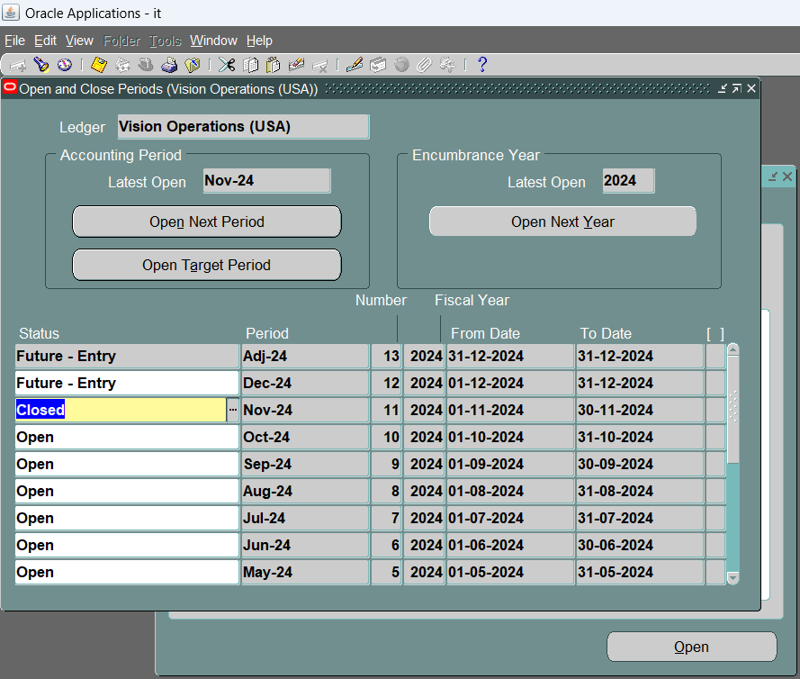
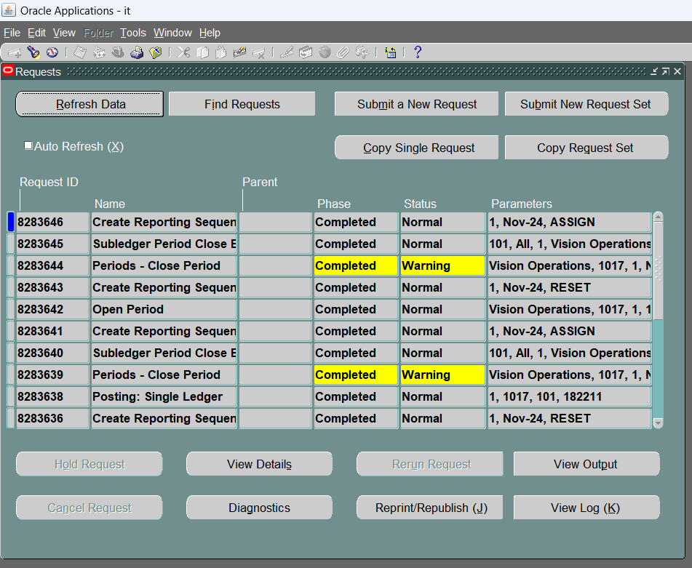
3- Click Close Period to close the selected period.

Slide 37
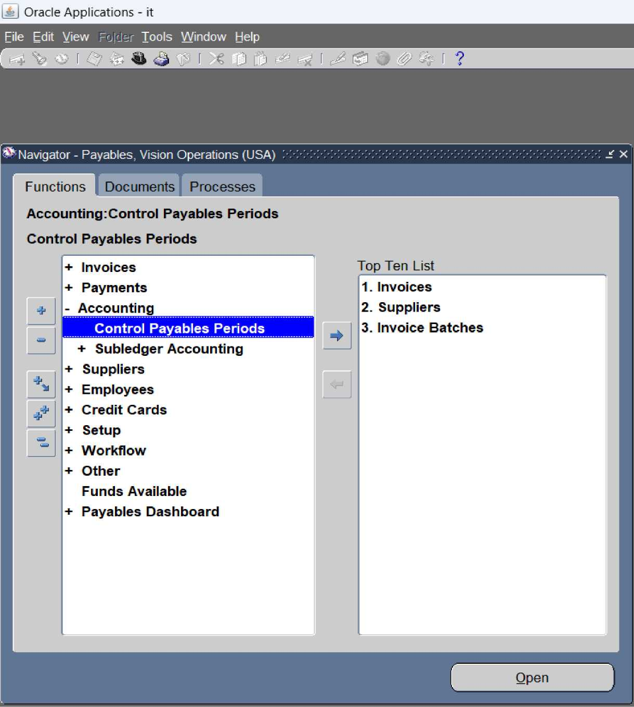
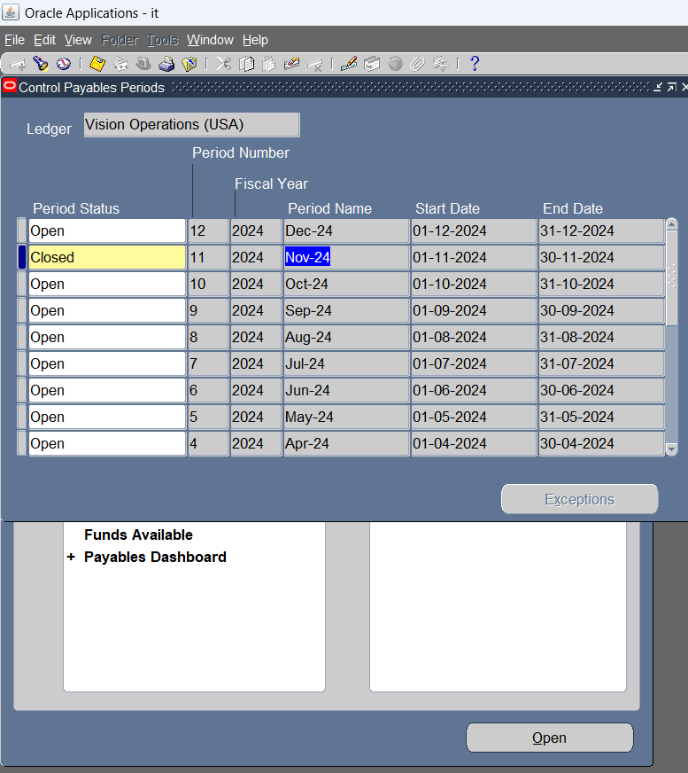
Close Sub-Ledgers
Access Sub-Ledger Modules:
1-Navigate to the Payables modules.
2-From the menu, select Control Periods.
3- Choose the period you want to close.

Slide 38
Mass Allocation
his method is used to allocate expenses to cost centers (which may be production departments, for example). It is a very important method for managing indirect costs, where the cost of an indirect item is expressed through the calculation of direct and indirect costs. For example, we may want to calculate the amount of electricity consumed directly in production (such as warehouses and factories) and consider this amount as part of the direct costs.

Slide 39
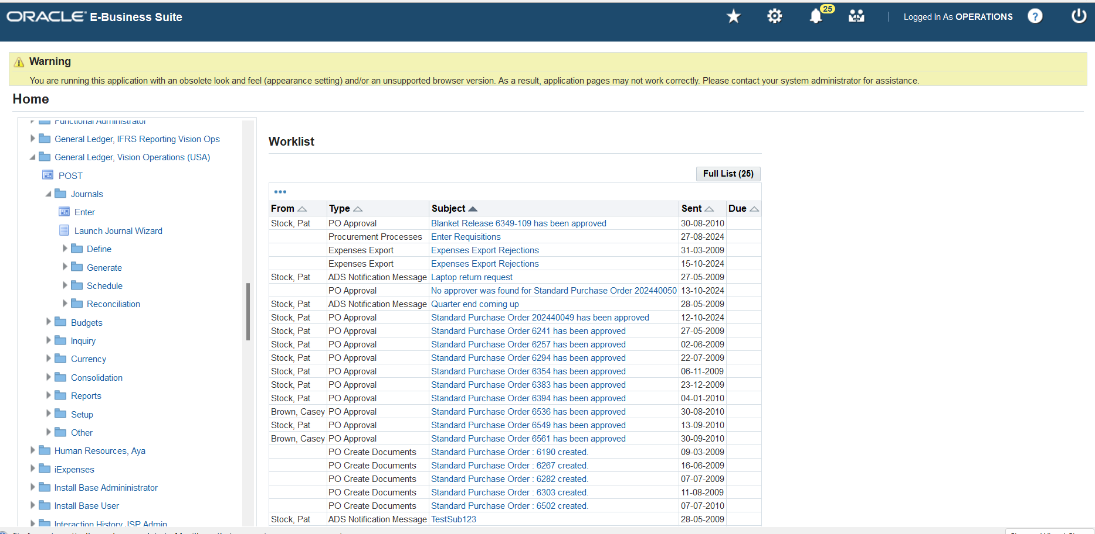
Mass Allocation From Navigations ● General Ledger > Journal > Enter .

Slide 40
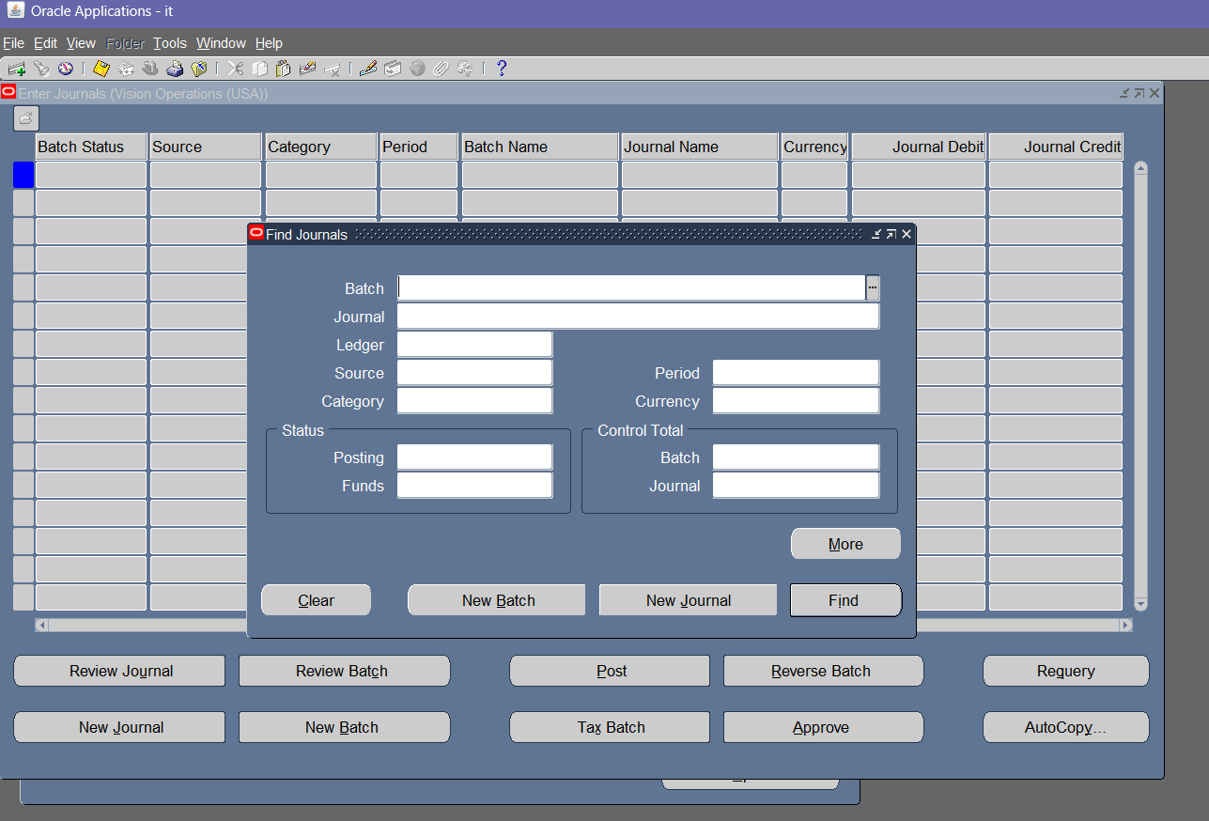
Then will appear

Slide 41
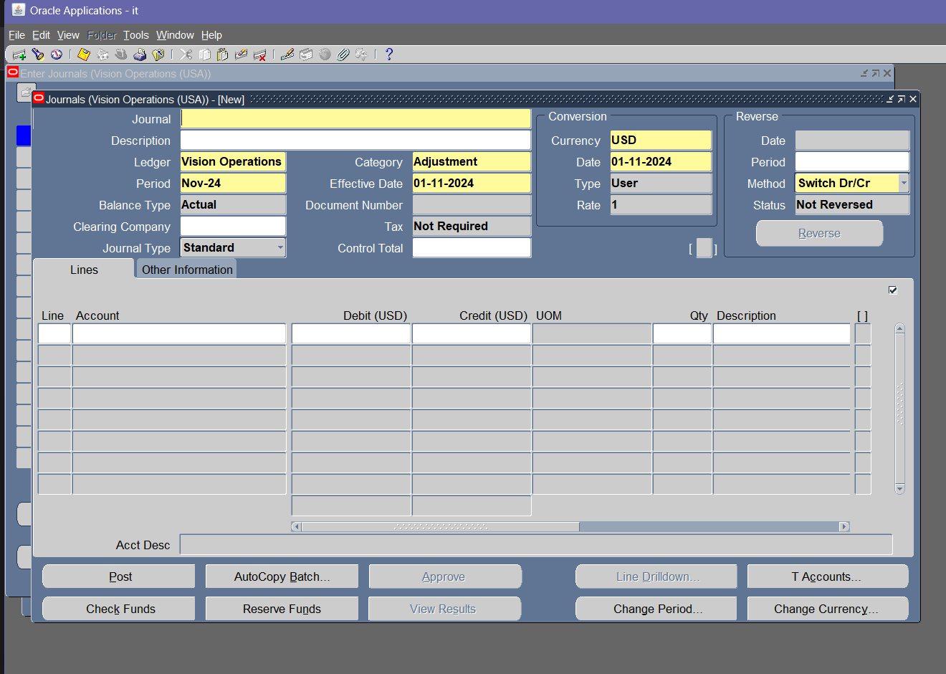
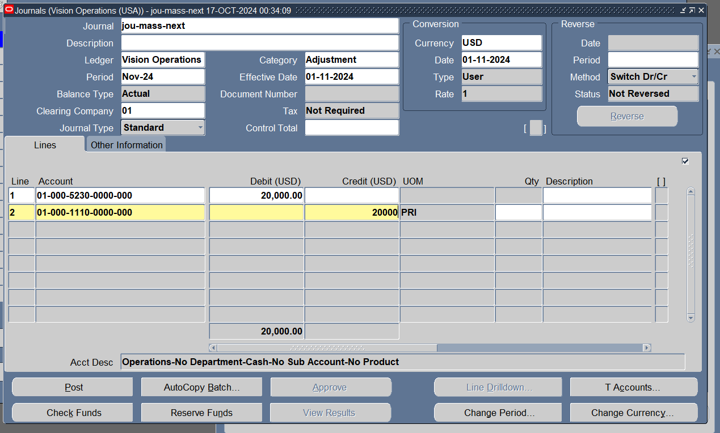
When I click on new job then will appear
I entered an entry without a cost center in the main currency, the dollar and click post

Slide 42
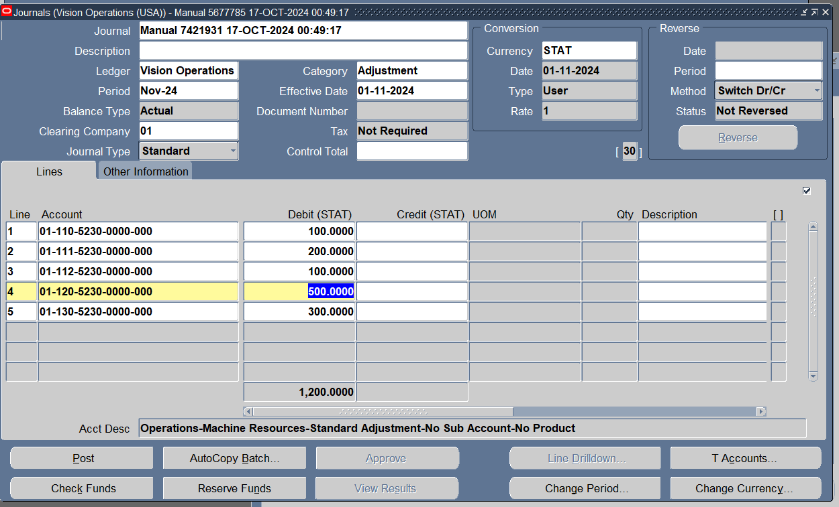
I entered the rates on which we will calculate the distribution of expenses in the entry and click post

Slide 43
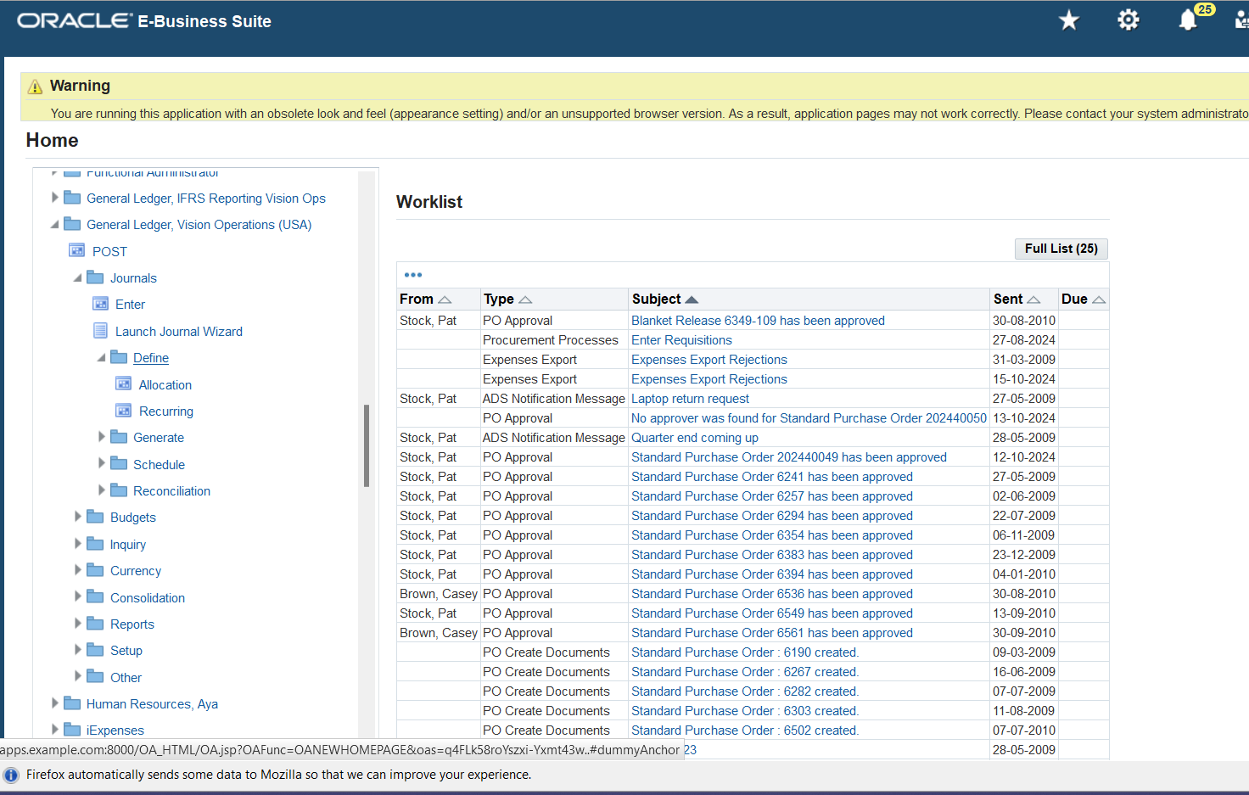
To complete the process
from Home page > Journals > Define > Allocation

Slide 44
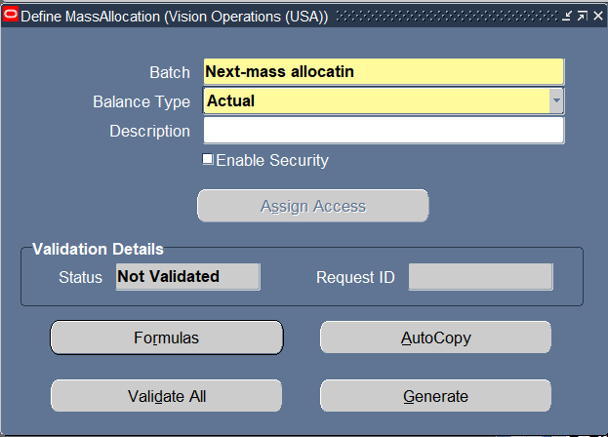
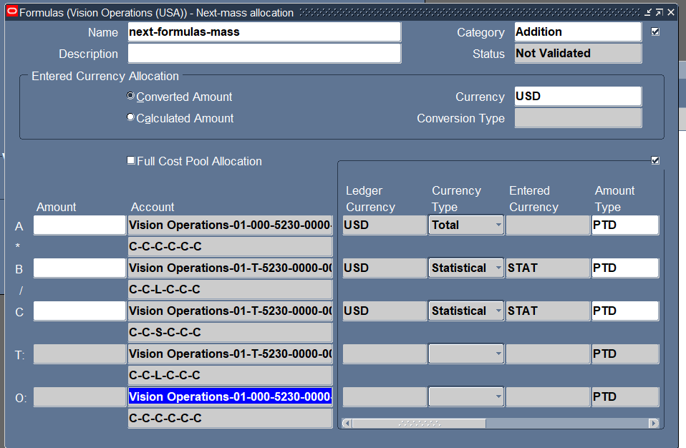
Appear this page
And click formulas
appear this page

Slide 45
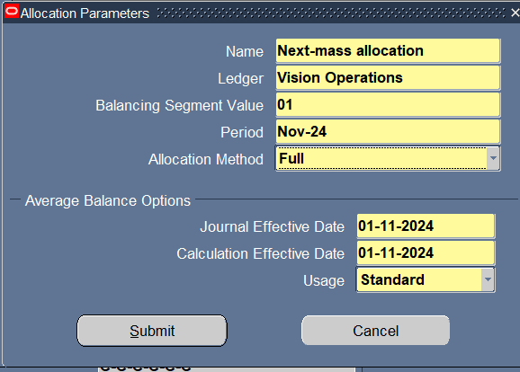
After saving we return to the original screen, where we click on Generate
Then we click on Submit

Slide 46
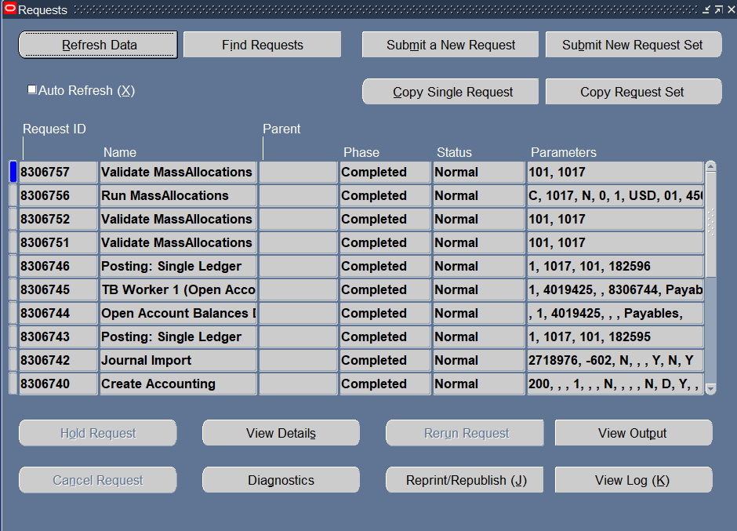

Slide 47
1-BUDGET
Define Budget, Organization and entering actual journal

Slide 48
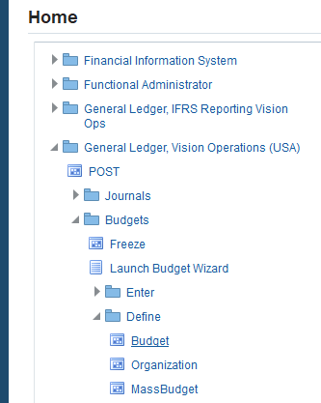
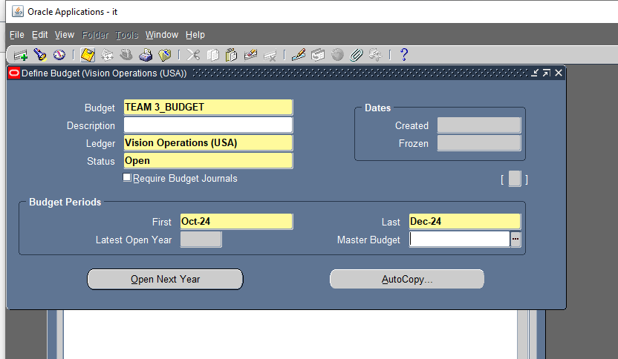
* Navigate to the Budget Window. * Enter a Name for the Budget*TEAM 3_BUDGET*. * Enter Budget Periods and Status*Oct-24-Dec-24*,Open.

Slide 49
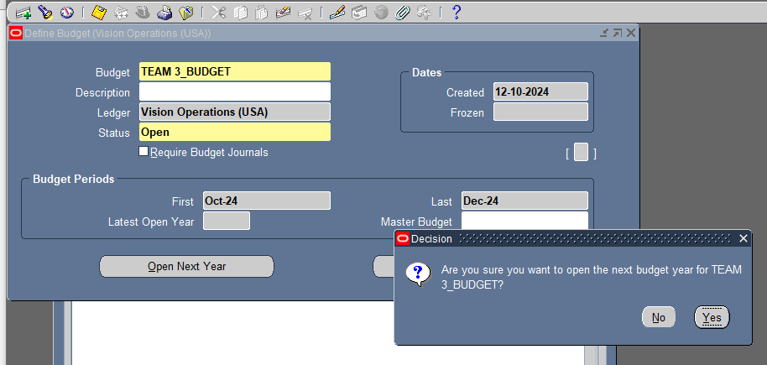
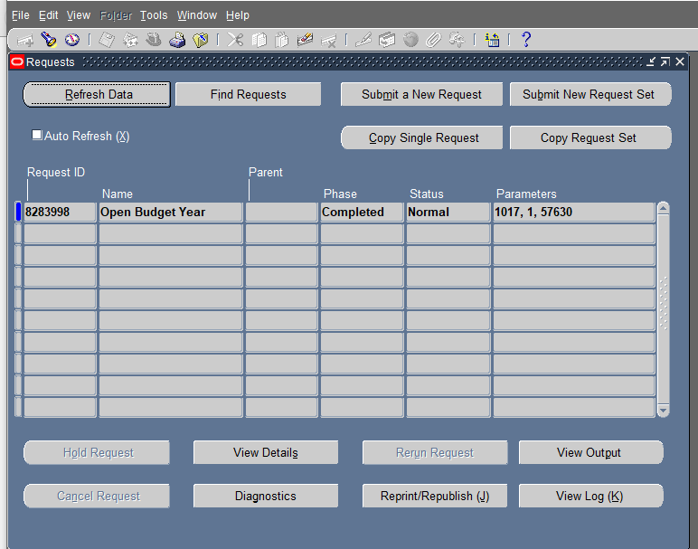
* Choose Open Next Year to open the first fiscal year of the Budget.

Slide 50
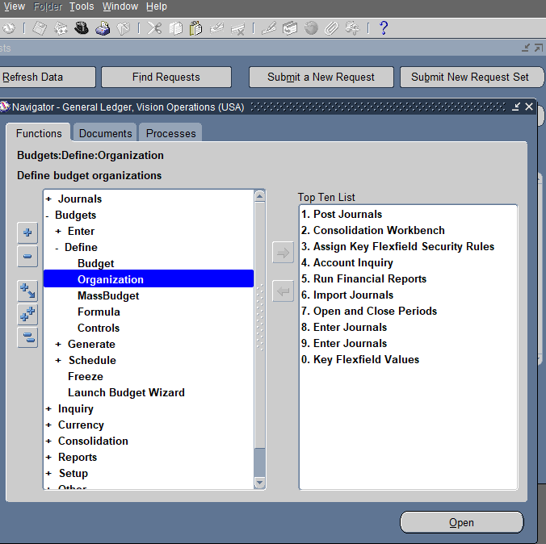
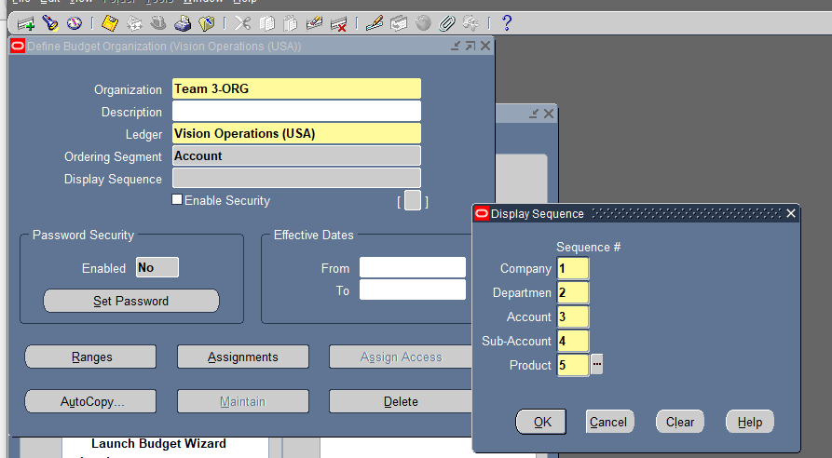
*Navigate to the Define Organization Window. *Enter Organization name *Team 3-ORG* and the Display Sequence*1,2,3,4,5* *Click Save. *Click Ranges.

Slide 51


*Select the Accounts to allocate the Budget. * Click Ok and then Save.

Slide 52

* Click View and choose Request. *Enter the Request ID.

Slide 53


*Navigate to the Enter Journal Window. * Enter The Budget name, Organization and Periods. * Click on Budget rules to enter Amounts for each account and period.

Slide 54


*Enter The Rule*Repeat Per Period* and Amounts. * Click on Apply.

Slide 55



Slide 56


*Click on Create Journals. * Enter Journal Batch*Team 3-Budget and Category*Budget*. *Click on Check Funds.

Slide 57


*Click on Reserve Funds then click on Done.

Slide 58


*Navigate to Enter Journals Window. *Click on Source and choose Budget.

Slide 59


*Click on Review Journal for Nov-24. *Click on Post.

Slide 60


*Click on Review Journal for Oct-24 and Dec-24. *Click on Post.

Slide 61


*Click on New and Enter Actual Journal.

Slide 62


*Click on Check Funds and Save. *Click on Reserve Funds.

Slide 63

*Click on View and Choose Request . * Enter the Request ID.

Slide 64
2-Financial Statement Generator (FSG)
Preparing an Income Statement

Slide 65


*Navigate to the Define Row Set Window. * Enter the Name*Team3-ROW* and Click on Save. *Click on Define Rows.

Slide 66


*Enter the Line*1* and Line Item*Revenues*. *Enter Indent. *Click on Account Assignments.

Slide 67


*Enter the line*2* and the Line Item *Expenses*. *Click on Account Assignments.

Slide 68


*Enter the Line *3* and the Line Item *Profit/Loss* *Enter Indent *2* and Underline Character *1* Before and After. *Click on Calculations.

Slide 69


*Navigate to the Column Set Window. *Enter Name *Team3_COLUMN*. *Click on Save. *Click on Build Column Set.

Slide 70


*Enter Sequence *1*. * Enter Name *Team3 column* and Amount Type *PTD-Actual. *Enter Width *18* and the format Mask * 9,999,999,99*. *Click on Apply. *Click on Define Report.

Slide 71


*Enter Report *Team3-Income-Statement and Title *Income-Statement. *Enter Row Set and Column Set. *Click on Run Report. *Click on Submit.

Slide 72


*Click on View and Choose Request. * Enter the Request ID. *Click on View Output.

Slide 73
Using Different Currencies
Sometimes, we need to enter entries in non-main currencies or convert our main currency into a foreign one in some cases. Therefore, there are several ways to handle currencies:
1- Exchange Rate Conversion Method:
This is when we set the exchange rate for foreign currencies used in the program to convert these currencies' values to their equivalents in the main currency. There are two different methods for this:
First: Manual Rate Method:
We set the exchange rate manually through the Type field, where we can directly change the foreign currency exchange rate from the cash entry screen. In this method, the foreign exchange rate changes to Entered with the note that the matching rate appears in the foreign currency rate field. The Accounted field remains unaffected.

Slide 74


Slide 75

Second: Exchange Rate Method
Instead of manually setting the exchange rate every time, we can use another type instead of the Corporate type, which is User, allowing the exchange rate value to be set once, either monthly or annually. This can be done through the following path:
Setup → Currencies → Rate → Daily

Slide 76



Slide 77

Currency Revaluation
currency revaluation is the process of adjusting the value of foreign currency-denominated account balances (typically assets and liabilities) to reflect current exchange rates at the end of an accounting period. The purpose is to account for fluctuations in exchange rates between the time transactions were recorded and the current reporting date.
Journal entery before revaluation Exchange rate

Slide 78

Update Exchange rate
Setup → Currencies → Rate → Daily

Slide 79

Path: Currency Revaluation
Where we put the currency and the accounts we want to revaluate for
evaluation generates journal entries to account for unrealized gains or losses, ensuring that the financial statements accurately reflect the correct value of foreign currency balances based on up-to-date exchange rates.

Slide 80



Slide 81

New entery showing the difference between old and new exchange rate

Slide 82


Change currency of unposted Journal

Slide 83



Slide 84

You can enter manual journal entries using an entered currency using the Enter Journals page. An entered currency is a currency that is not the ledger currency. If you use reporting currencies (journal or subledger level), an entered currency is a currency that is not the currency of the reporting currency.

Slide 85
GL REPORTS
GL REPORTS
TRIAL BALANCE
ACCOUNT ANALYSIS
BALANCE SHEET
GOURNALS REPORT
INCOME STATEMENT
BUBGET VS ACTUAL
are used for tracking and analyzing financial data. These reports support financial monitoring, compliance, and decision-making.

Slide 86

GL Reports
From view > requests > submit new request > single requests

Slide 87


Slide 88
Trail Balance Report
ATrial Balance Report is a financial report that provides a summary of the balances of all general ledger accounts for a specified period. It displays the total debits and credits for each account, along with the beginning and ending balances. The report is used to ensure that the general ledger is balanced, meaning that total debits equal total credits, which is critical for accurate financial reporting.
This report helps verify the accuracy of financial transactions and is often used as a preliminary step before generating financial statements, such as the income statement and balance sheet.

Slide 89


Slide 90

Researsh by request ID of report

Slide 91


Slide 92
Account Analysis Report
An account Analysis Report is a detailed financial report that provides a breakdown of transactions for specific general ledger accounts over a specified period. It shows the beginning balances, detailed transaction activity (debits and credits), and ending balances for each account.
The report is useful for reviewing the activity within an account, tracing transaction details, and auditing specific entries. It helps users analyze how specific accounts were impacted by various journal entries and transactions, providing transparency and supporting financial reconciliation and reporting.

Slide 93

ACCOUNT ANALYSIS REPORT

Slide 94


Slide 95
General Ledger Report
A general Ledger Report is a comprehensive financial report that provides detailed information about all the transactions posted to the general ledger over a specific period. It includes the beginning balances, transaction activity (debits and credits), and ending balances for all general ledger accounts.
The report is essential for tracking and reviewing all financial transactions, ensuring accuracy in the accounting process. It supports financial analysis, auditing, and helps in preparing financial statements such as the balance sheet and income statement. The General Ledger Report is typically used by accountants and financial managers to monitor the organization’s overall financial health.

Slide 96

GENERAL LEDGER REPORT

Slide 97


Slide 98
Thanks GOD
Thanks our supervisor : Mr. Ehab Ahmed
Thanks our Team :
Nabil Mohammed
Verna Philip Zakaria
Omar Makram Abdellah
Kareem Mostafa fouad Ali
Esraa Hamdy Osman
Mohamed Ahmed Ahmed Abdellah

Slide 99
Thank you for your attention. If there are any questions,
We would be happy to answer them

